Slide 1
DeAnna M. Rowe Costume Design and Technology www.gypsydreamstudios.com

Slide 2
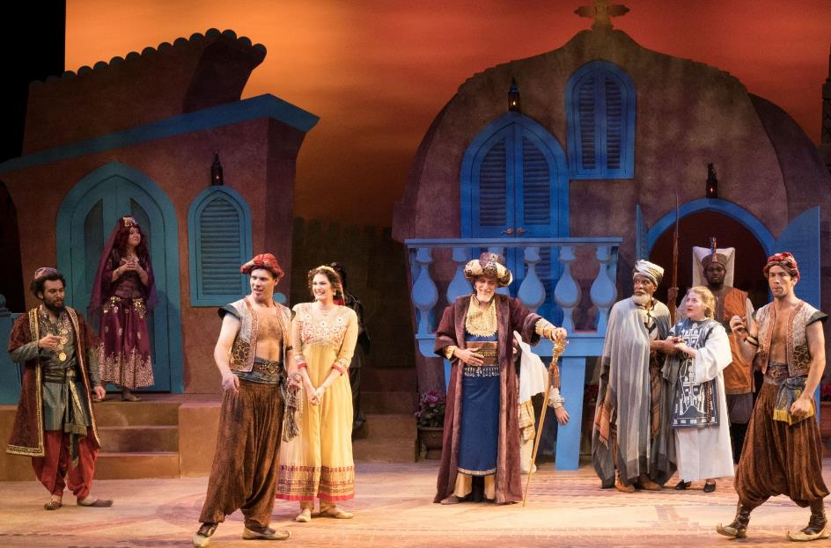
A Comedy of Errors Tennessee Shakespeare Company Director: Tony Simotes Scenic Design: Brian Ruggaber Lighting Design: Anthony Pellecchia Sound Design Jo Sandburg Photo credit: Joey Miller

Slide 3
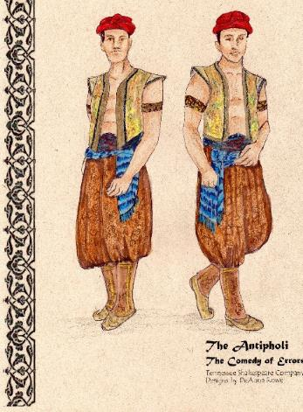
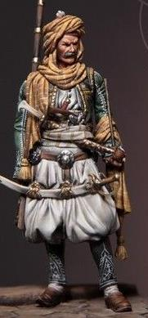
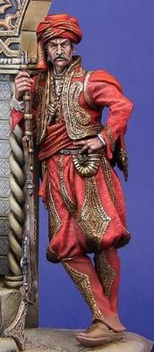
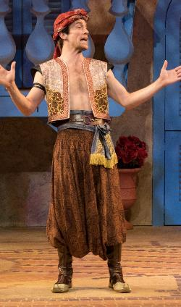
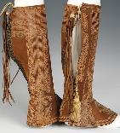
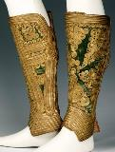
Notes:
Not sure about the headwear for these guys. The hats on the top right might read a little too silly and be un-practically large. Maybe smaller turbans or fez?
I like the ornate gaiters (fake boots) and the puffy pants with layers on top. Maybe ornate tunics that are belted with a sash or more plain tunics with a short ornate vest over top. I don’t mind the idea that they are not exactly identical but in the same color with similar enough details to get confused.

Slide 4
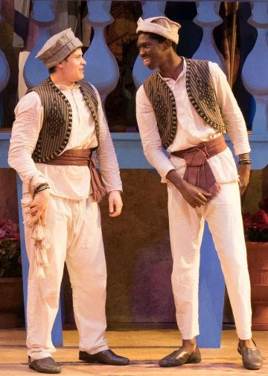
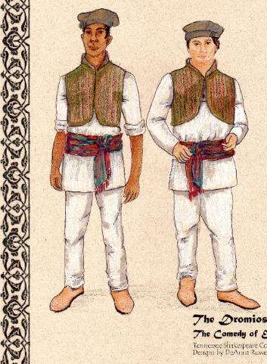
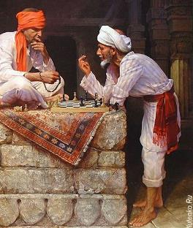

Slide 5
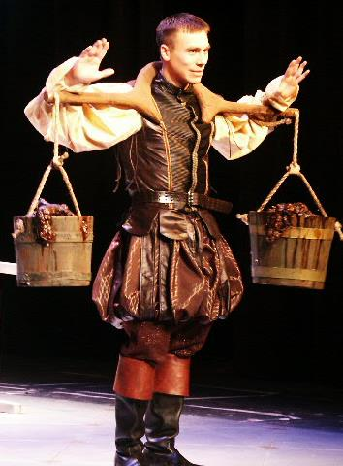
Goodnight Desdemona, Good Morning Juliet Ohio University My designs. Costumes patterned and constructed by my MFA Costume Technology students
Notes:
Goodnight Desdemona, Good Morning Juliet
Iago’s sleeves were detachable.
As the head of the Costume Technology program I enjoyed getting to design this show.

Slide 6
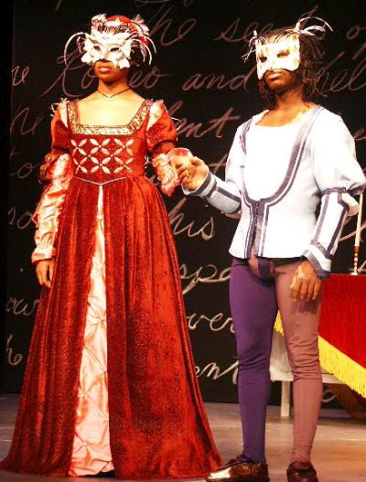
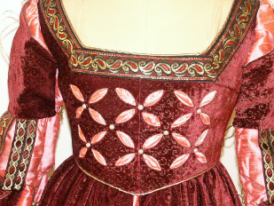
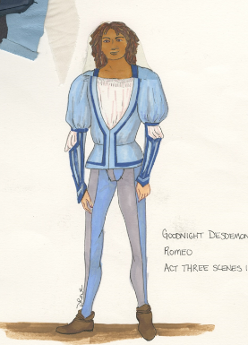
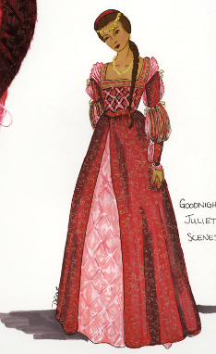
Juliet’s gown was draped by one of my MFA Costume Technology students. Romeo’s leather doublet was draped by an overhire draper.
Notes:
Juliet’s gown was a draping project for one of my MFA Costume Technology students. Romeo’s leather doublet was draped by an overhire draper. The masks were created in a weekend workshop on Wonderflex.

Slide 7
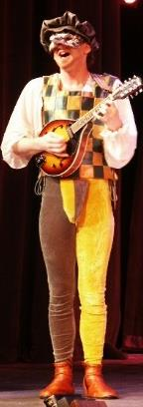
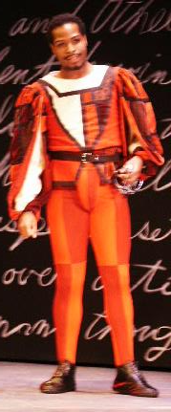
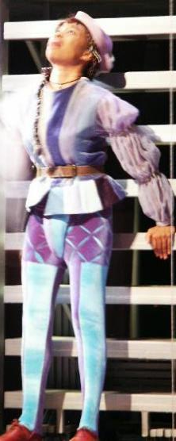
Tights and shoes We made several pairs of tights for this show. I developed the pattern and it has since been an important offering for private commissions. The shoes were the project of an MFA student.
Notes:
We made several pairs of tights for this show. I developed the pattern and it has since been an important offering for private commisisons. The shoes were the project of an MFA student.

Slide 8
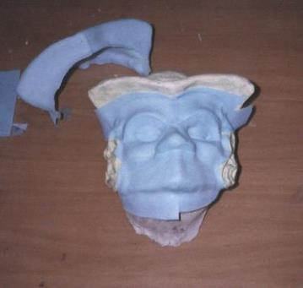
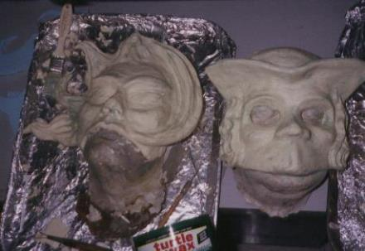
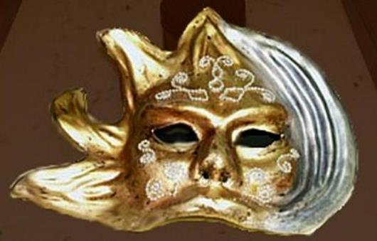
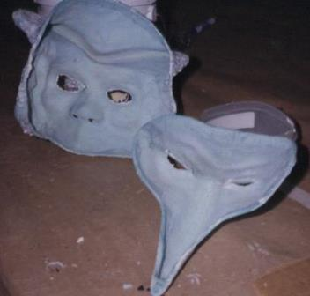
Mask making with Wonderflex
Notes:
Some of the steps in the mask making process. Shown here are the clay sculpted positive forms. Then the wonderflex layer is created over the positive form. Next you see the back side of the mask and finally a finished painted version.

Slide 9
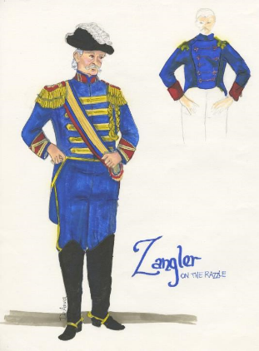
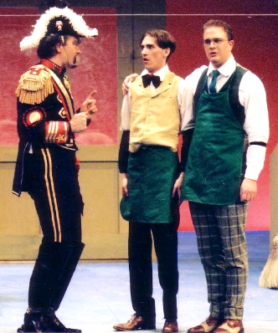
On the Razzle Allentown College My designs. Costumes patterned and constructed by undergraduate students Winner of ACTF Kennedy Center Award for Costume Design.

Slide 10
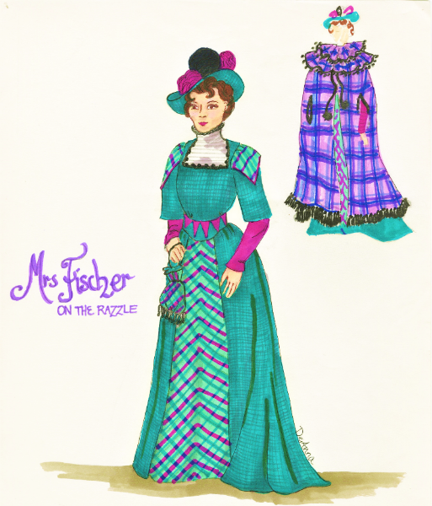
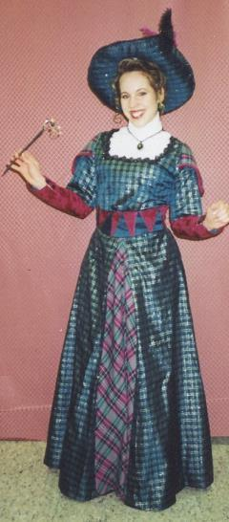
On the Razzle
The “Scottish Get-Up” is supposed to be ridiculous and over-the-top. This was draped by a Junior acting major.
Notes:
The “Scottish Get-Up” is supposed to be ridiculous and over-the-top. Unfortunately, no photos of the cape which was fabulous! This was draped by a Junior acting major.

Slide 11
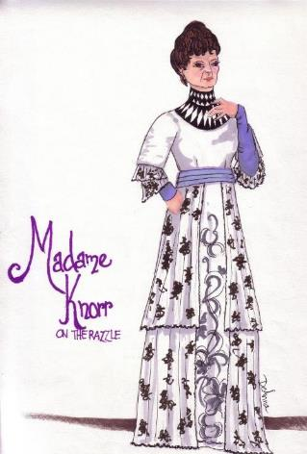
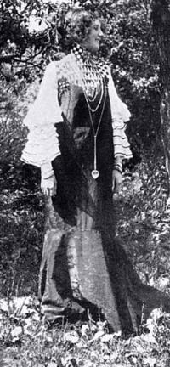
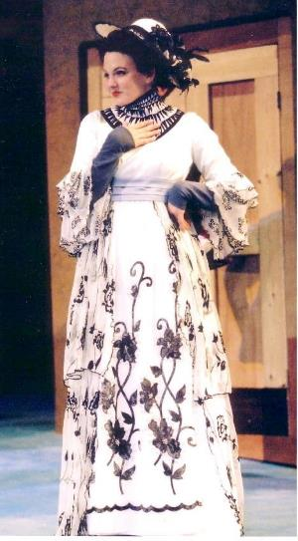
On the Razzle
The inspiration for this dress was Emilie Floge-the muse of Gustave Klimt. Our designs for all the design elements were “Klimtian”.
Notes:
The inspiration for this dress was Emilie Floge-the muse of Gustave Klimt. Our designs for all the design elements were “Klimtian”.

Slide 12
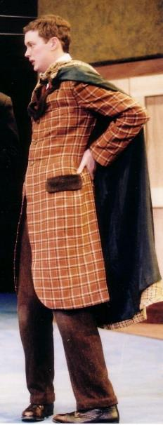
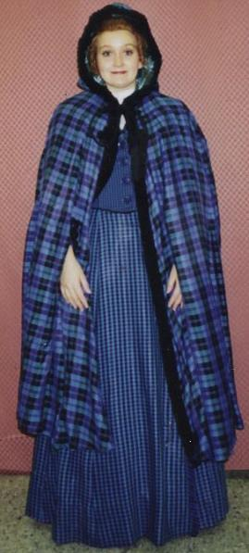
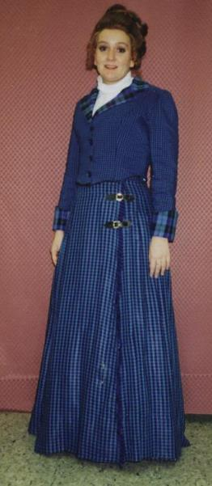
There was a lot of plaid! Brown plaid coat was hand tailored by a senior acting major. Periwinkle outfit was draped and constructed by sophomore costume tech student.

Slide 13
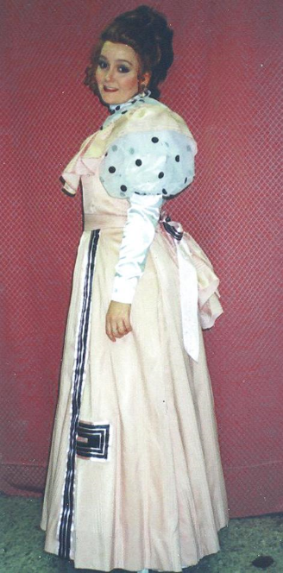
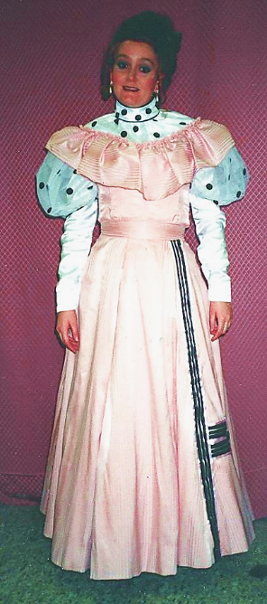
On the Razzle Creative re-construction of an 80s prom dress.
I also styled the wigs for this show.

Slide 14
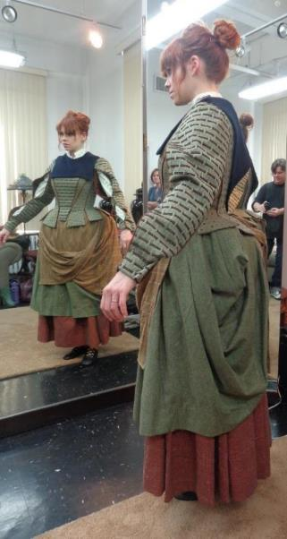
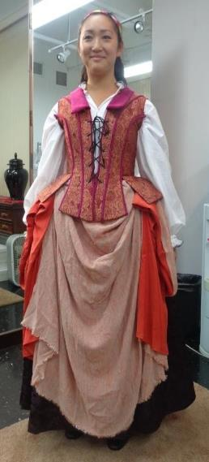
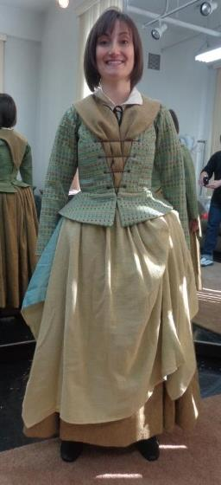
William Ivey Long designs for the Broadway touring production of Cinderella. I was commissioned to re-create the designs for the skirt ensembles for 9 villagers, as well as grade the Crazy Marie costume from a size 6 to size 22.
Notes:
I was commissioned to create the skirt ensembles for 9 villagers. These included bum roll basques, petticoat, underskirt, overskirt and aprons. I was sent the fabric, measurements and specs and sent the garments to the studios for fittings. They sent me the photos of the fittings with the notes that I completed and sent back. I also created a new garment for Crazy Marie who was several sizes larger than the original actress. This was for the Broadway touring production of Cinderella.

Slide 15
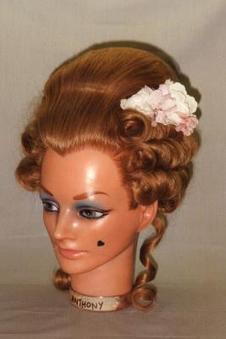
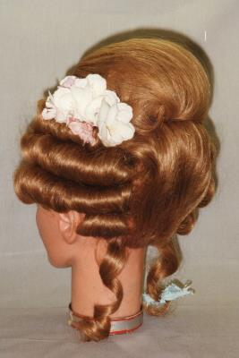
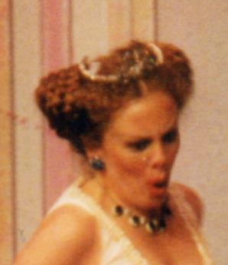
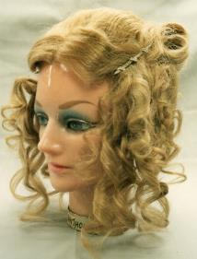
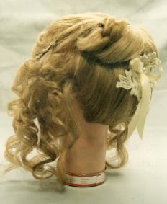
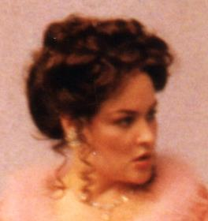
Hair styling

Slide 16
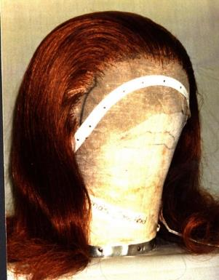
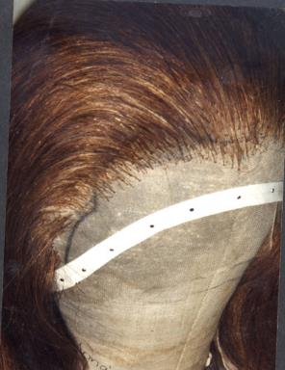
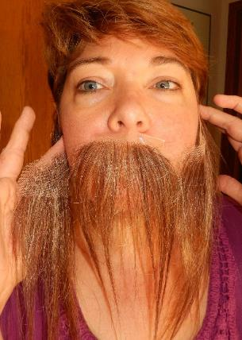
Wig ventilation techniques
Fronted wig
Un-cut mustache and mutton chops

Slide 17
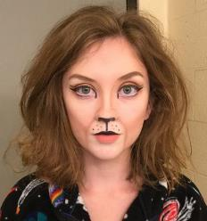
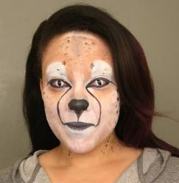
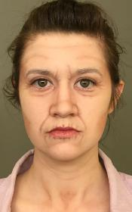
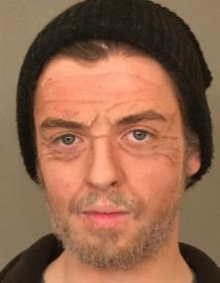
Makeup Class – University of Memphis
Notes:
Some of our best results from Stage Makeup class – a 2 credit course meeting once a week.

Slide 18
This is a private commission based on the designs for The Three Musketeers. It is a popular favorite that I have recreated several times.
“The Porthos”
Leather slashed doublet
Leather full trousers
Leather sword baldric
Patterning, cutting, stitching

Slide 19
Victorian Bride and Groom
Tailored 4-piece groom’s suit
Bride’s 2-piece dress and jacket
This was a wonderful design project – mail order Bride and Groom….clothes. I never actually met them. I designed and tailored their garments based on measurements and many emails. I was fortunate to find very luscious silks and wools for this project.

Slide 20
Cyrano de Bergerac at South Coast Repertory
For this production I draped the 2 ensembles for Christian. One was corduroy and the other lambskin. I also draped Roxanne’s gown. Designs by Shigeru Yagi.

Slide 21
South Coast Repertory cutter/draper
Notes:
At South Coast Rep I was the head cutter/draper. I primarily worked on women’s wear but occasionally got to do something for the men – particularly if it was period or fantasy. Designs shown by Shigeru Yagi and Angela Calen.

Slide 22
A Connecticut Yankee in King Arthur’s Court South Coast Repertory My costume designs for Conservatory Production
Notes:
A Connecticut Yankee in King Arthurs Court – designed and constructed by me for South Coast Repertory Theatre Conservatory Program.
I had a tiny budget and a small amount of shop support. Mostly it was a one-woman show.

Slide 23
Sleeping Beauty South Coast Repertory My costume designs for Conservatory Production

Slide 24
Sleeping Beauty

Slide 25
My line of Renaissance-Inspired jewelry includes chains of office, bodice embellishments and other pieces all inspired by portraiture of the Italian Renaissance.
Notes:
My line of Renaissance-Inspired jewelry includes chains of office, bodice embellishments and other pieces all inspired by portraiture of the Italian Renaissance.

